Slide 1
Version control system
Dr Hisham Khalil

Slide 2
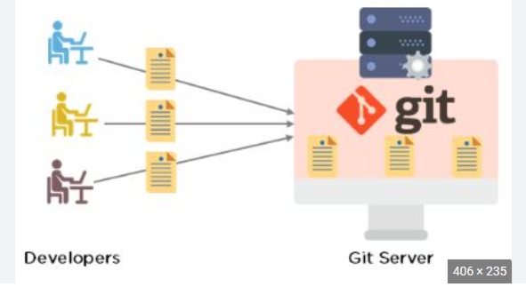
Development and git

Slide 3
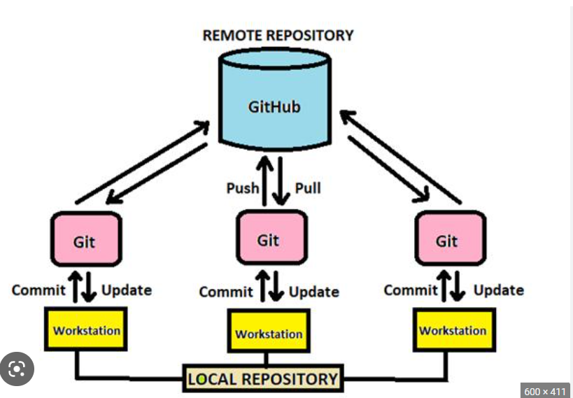

Slide 4

Git and github

Slide 5

Git and project management

Slide 6
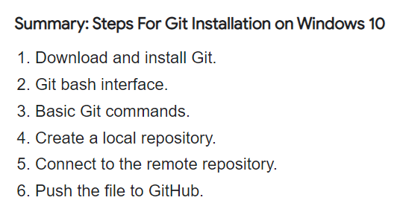
Git installation to local system (Win)

Slide 7
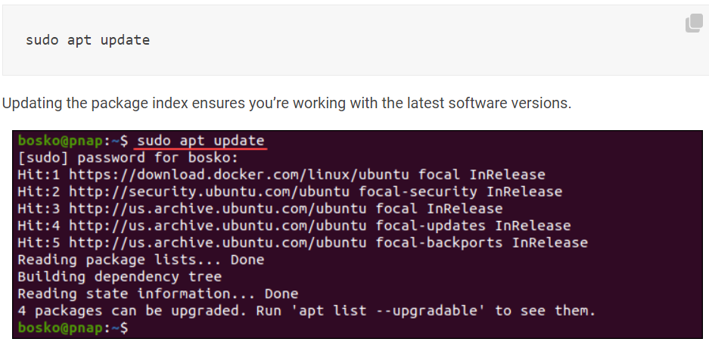
Installation on Linux

Slide 8
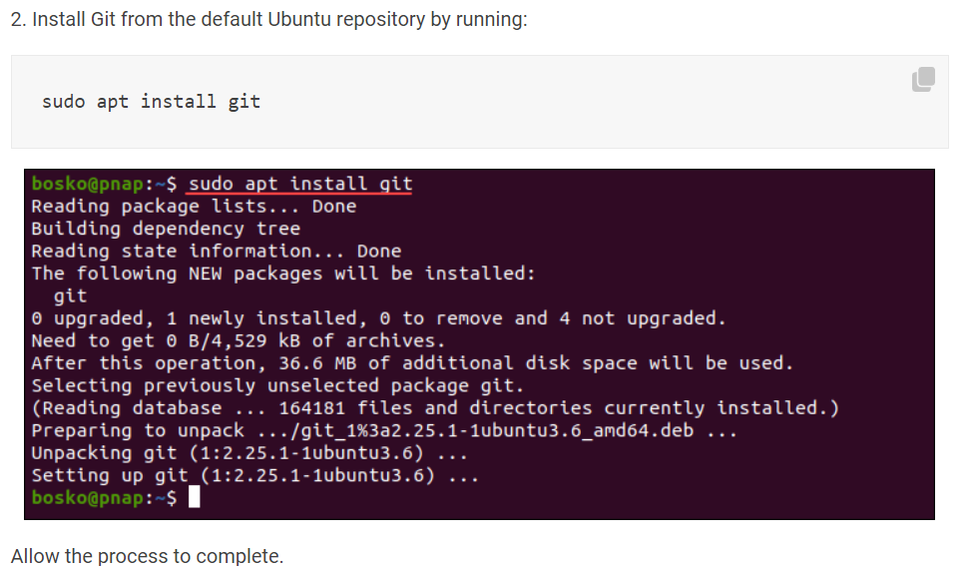
Install git

Slide 9
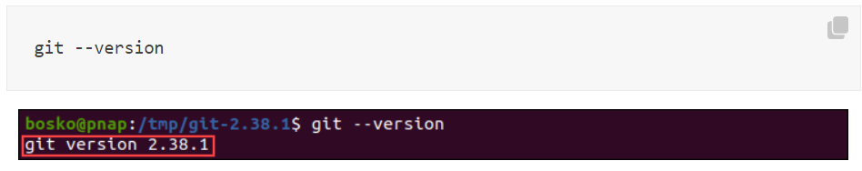
Git version

Slide 10
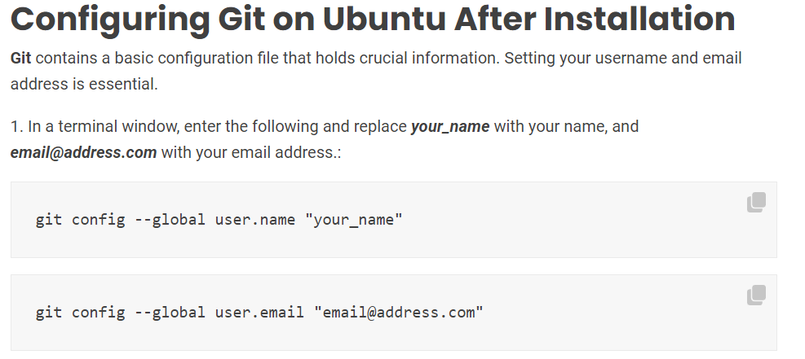
Config git

Slide 11
Adding new file/code to github
Place file in the folder
Check git log
Then add “git add .” or “git add --all” or “git add -A”
Note that there will need to add commit message for github repo so do commit using “git commit –m ‘I have added new files’ ”
Then last step to push to specific branch of the remote repo
Git push

Slide 12
Create branch at local and send to remote
See existing branches git branch
Add branch git branch IET2ndLec
Again check branch
Change header using git checkout IET2ndLec

Slide 13
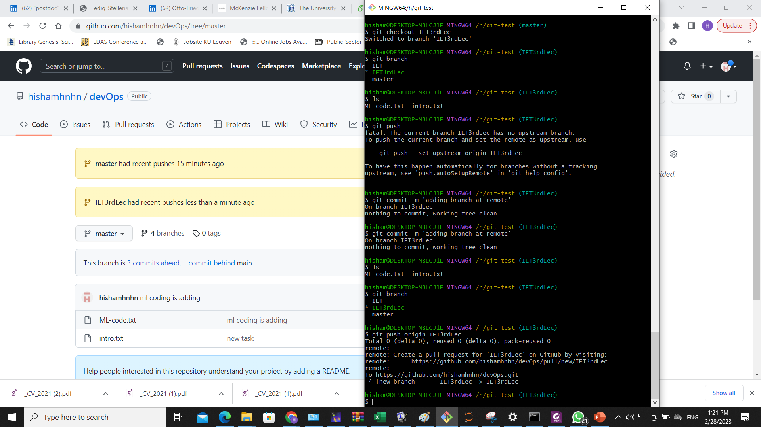

Slide 14
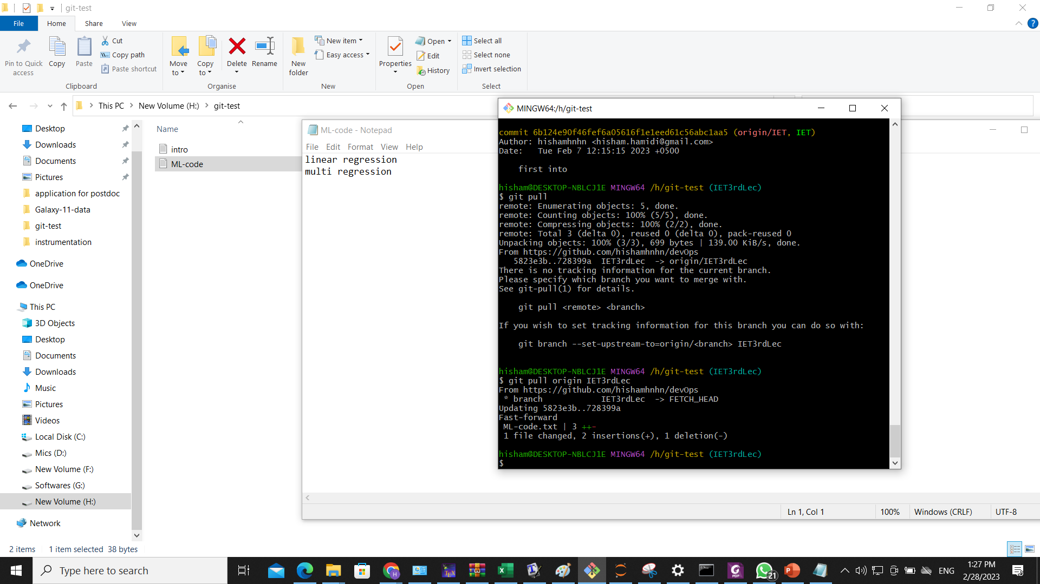
Pull update from remote

Slide 15
Task to do
Create branch at remote
Pull branch from remote

Slide 16
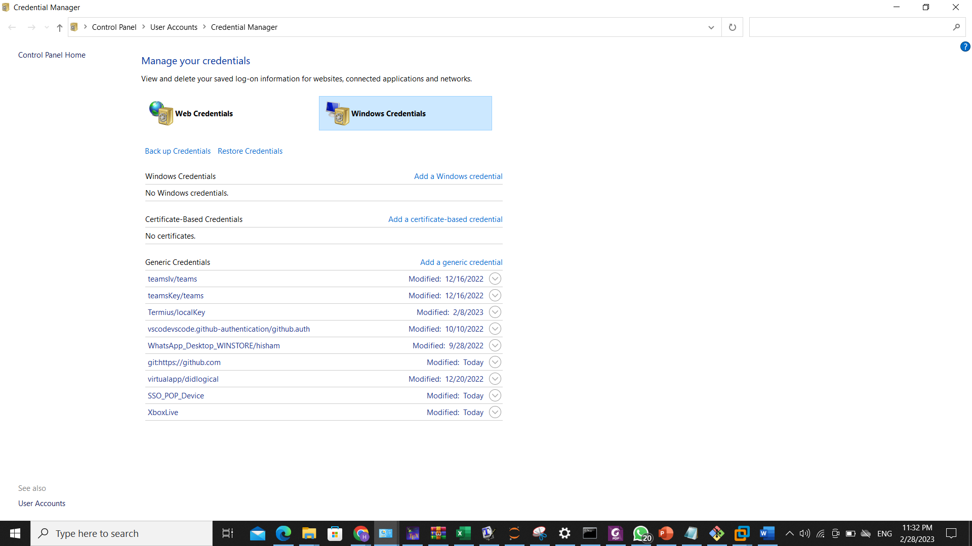
Git push issues
Window remove pw
Then add in git

Slide 17
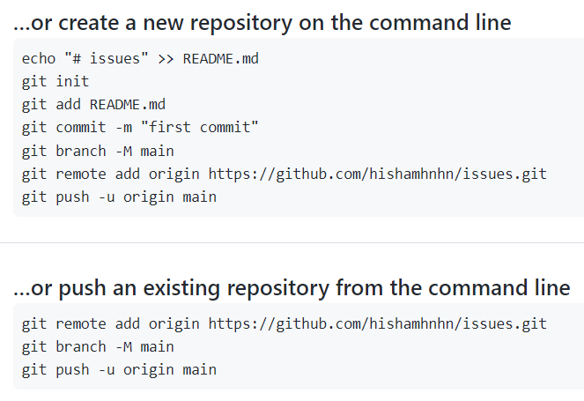
How to gen

Slide 18
Save user name and pwd
git config credential.helper 'cache --timeout=3600'

